Slide 1
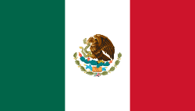
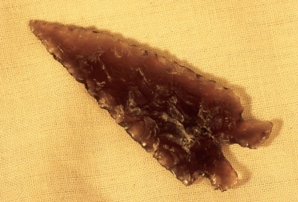
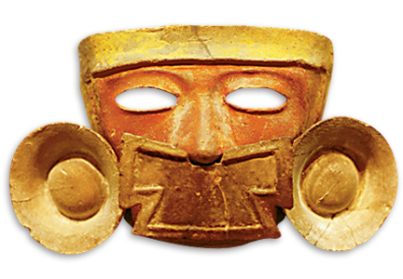
Worlds Apart: The Americas and Oceania

Slide 2
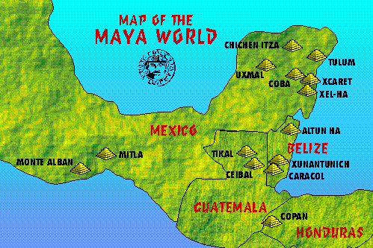
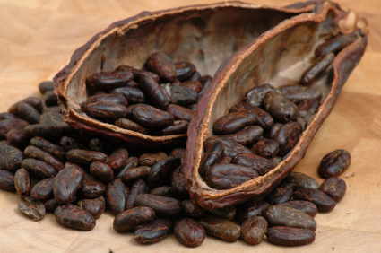
Maya 250 CE-900 CE
Located in Mesoamerica
Hot, humid jungle
Harvest maize, beans, corn, squash, and cacao
Cacao beans was used as currency and a beverage for the nobles. It is used to make chocolate.

Slide 3
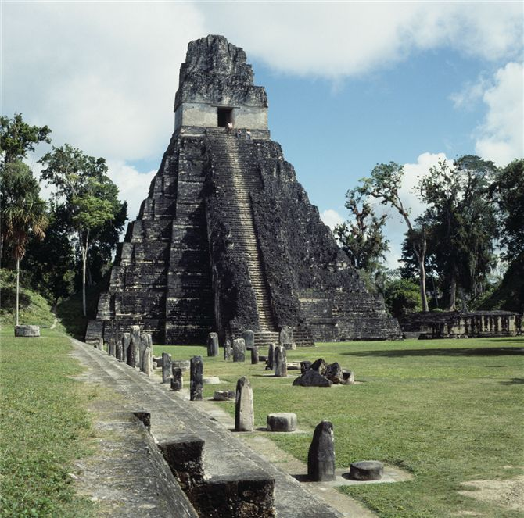
Political Structure
City-States
Examples
  Tikal, Chichen Itza, Palenque
Temple of the Giant Jaguar at Tikal, which served as funerary pyramid for Lord Cacao, a prominent Maya ruler of the late sixth and early seventh centuries c.e. Why might a Maya ruler wish to associate himself with a jaguar?

Slide 4
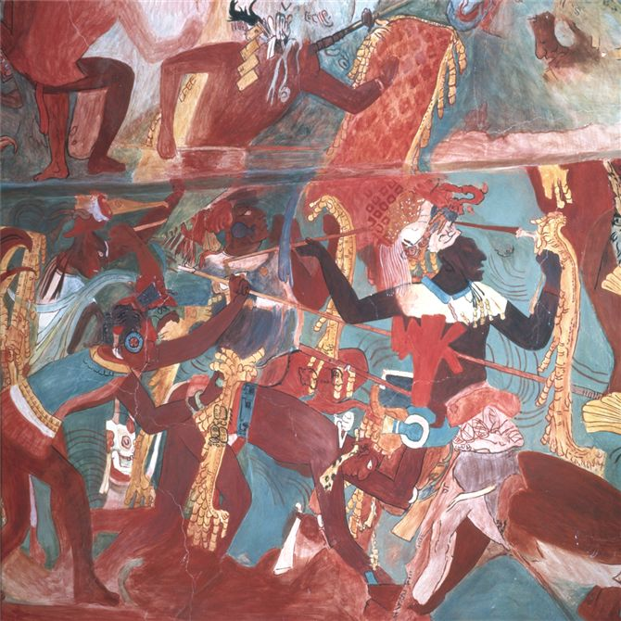
Mayan Warfare
City-states fought w/ each other
Purpose was to capture them
Those captured brought prestige to city-state
Used as slaves or sacrifice
A vivid mural from a temple in the small Maya kingdom of Bonampak (in the southern part of modern Mexico) depicts warriors raiding a neighboring village to capture prisoners who will become sacrificial victims.

Slide 5
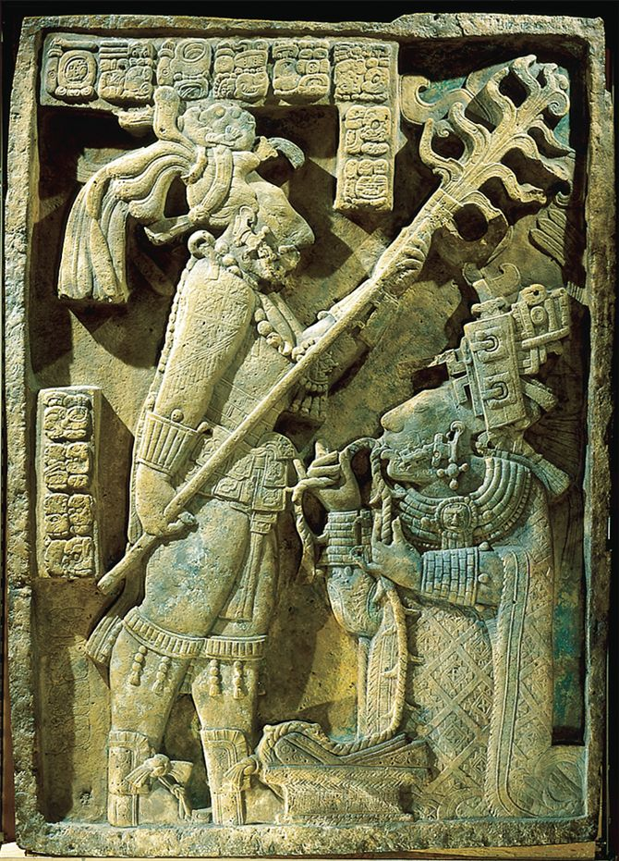
Religion
Bloodletting
Religious and political ritual
  Pierce themselves with stone knives and offer blood to feed the gods
In this stone relief sculpture, a Maya king from Yaxchilán (between Tikal and Palenque in the southern Yucatan peninsula) holds a torch over a woman from the royal family as she draws a thorn-studded rope through a hole in her tongue, so as to shed her blood in honor of the Maya gods.

Slide 6
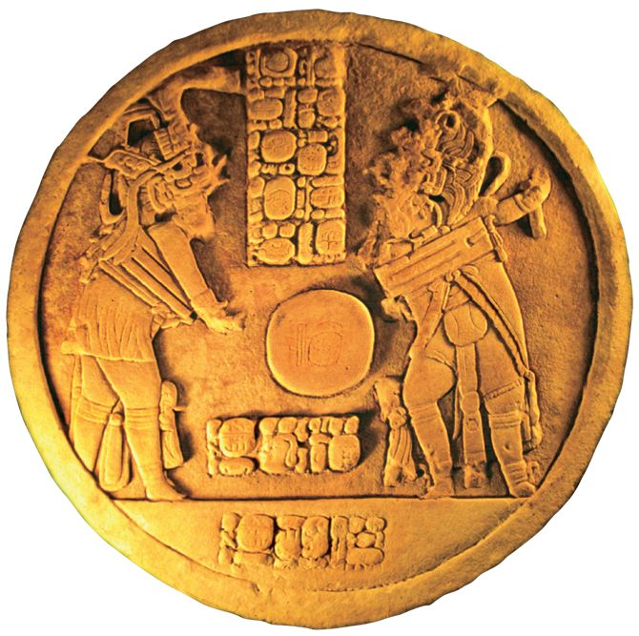
Cultural Achievements
Ritual ball games
  2-4 members against each other
  Players score points by propelling a rubber ball through a ring w/out using hands
    8” in diameter ball
    Heavy/hard
  Use feet, hips, torso, shoulders, elbow
A limestone altar carved in 796 c.e. depicts two Maya kings playing a ritual ball game to celebrate the negotiation of an agreement.

Slide 7
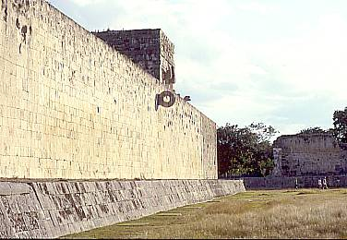
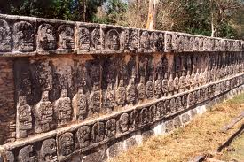
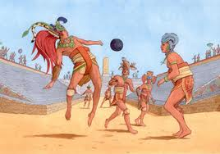
Reasons for game
Competition for sport
Political
  Conclusion of treaties
  High-ranking captives forced to play
  Loser sacrificed to gods
Alongside some ball courts were skull racks from the severed heads

Slide 8
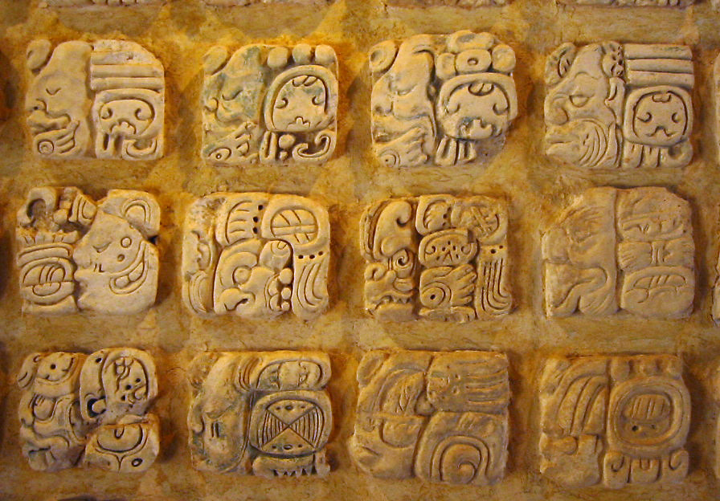
Writing
Most flexible and sophisticated of early Americas
Ideographic elements(like China) and symbols for syllables
1960s began deciphering it
Books destroyed by Spanish
Popol Vuh
  Creation myth preserved
  Gods created humans out of maize and water

Slide 9
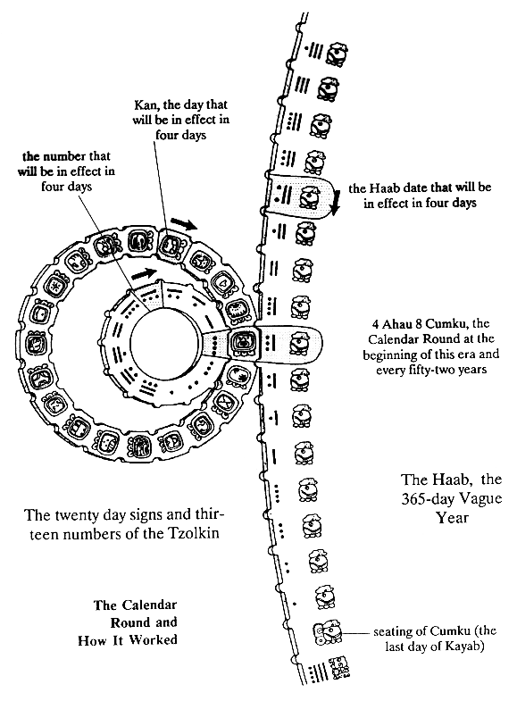
Maya Calendar
2 kinds of years
Solar calendar that governs agricultural cycle
  365
Ritual Calendar governs daily affairs
  260 days

Slide 10
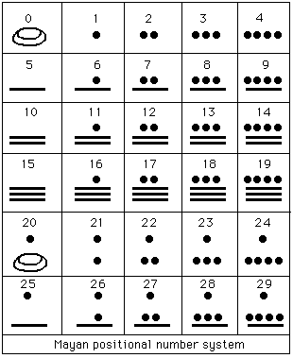
Mayan Math
Invent the concept of zero and used a symbol to represent math
Base 20

Slide 11
The Toltecs : 950-1150 CE
Regional states in central Mexican valley
  Religious and cultural influence of collapsed Teotihuacan
  Intense warfare
Toltecs migrate from north-west Mexico, settle at Tula (near modern Mexico city)
  High point of civilization: 950-1150 CE
  Urban population of 60,000, another 60,000 in surrounding area
  Maintain
  Subjugation of surrounding peoples
Civilization destroyed by internal strife, nomadic incursions 1175 CE

Slide 12
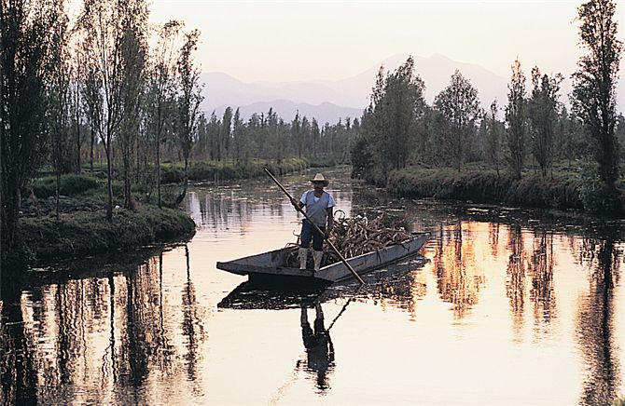
The Mexica (also known as the Aztecs)
One of several groups of migrants, mid 13th c. CE
  Also known as Aztecs b/c they dominated the Triple Alliance
Settled c. 1375 CE in Tenochtitlan (later becomes Mexico City)
Dredged soil from lake bottom to create fertile plots of land
  Chinampas, up to 7 crops per year
  Lake also served as natural defense
Although the lakes of central Mexico have largely disappeared, a few chinampas survive, such as this one in Xochimilco, near modern Mexico City

Slide 13
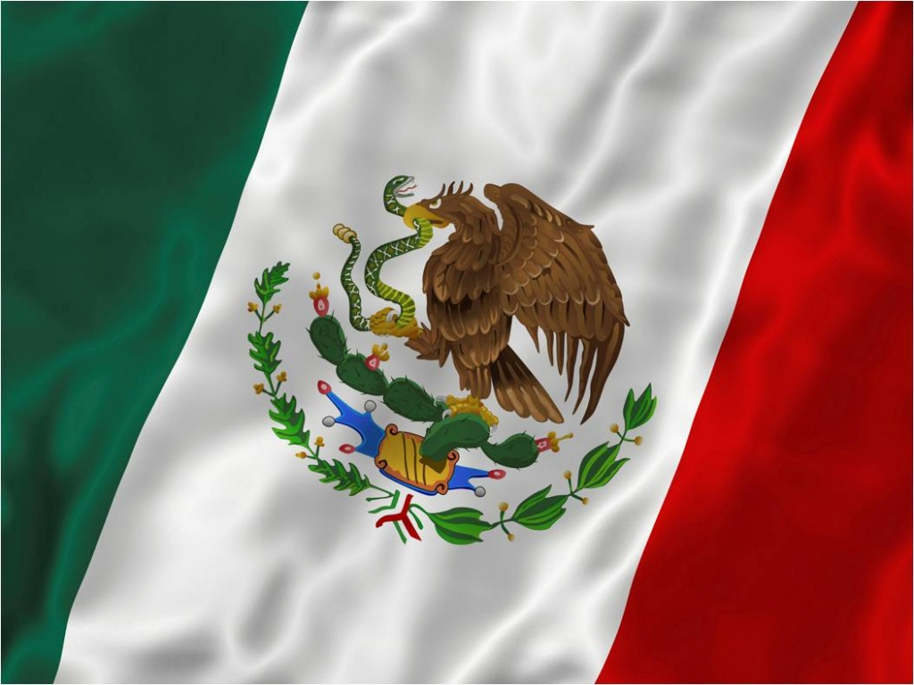
Mexican Flag

Slide 14
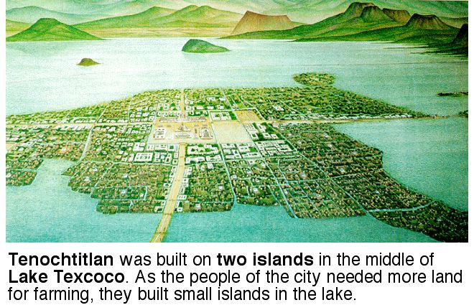
Aztec Empire
Mexica develop tributary empire by 15th century
Itzcóatl (1428-1440)
  “the Obsidian Serpent”
Montezuma I, 1440-1469)
  Both launch military campaigns to expand
Joined with Texcoco and Tlacopan to create Aztec Empire: known as Triple Alliance
  Impose rule on 12 million people
  Excluded only the northern and western regions

Slide 15
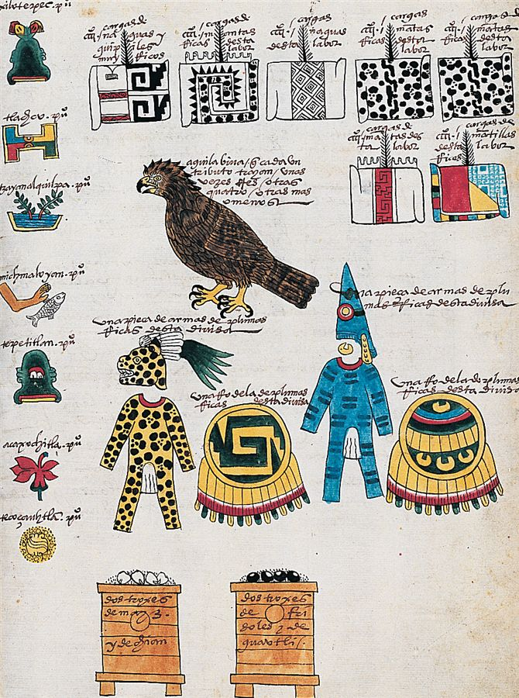
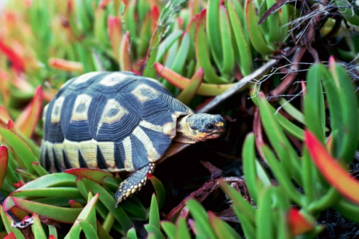
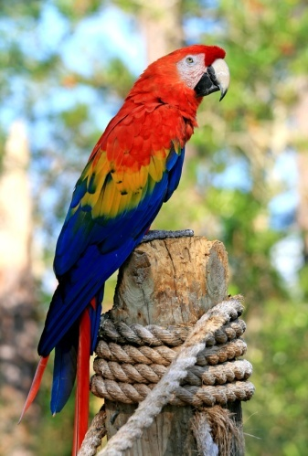
Tribute and Trade
Purpose of Triple Alliance was to exact tribute and trade
Receive textiles, rabbit-fur blanket, embroidered clothes, jewelry, and obsidian knives
Merchants took items to trade for tortoise shells, jaguar skins, parrot feathers, seashells, game, cacao, vanilla beans
A Spanish copy of a Mexica list records tribute owed by six northwestern towns to the ruler Motecuzoma II. Each two years the towns delivered, among other items, women's skirts and blouses, men's shirts, warriors' armor and shields, an eagle, and various quantities of maize, beans, and other foods

Slide 16
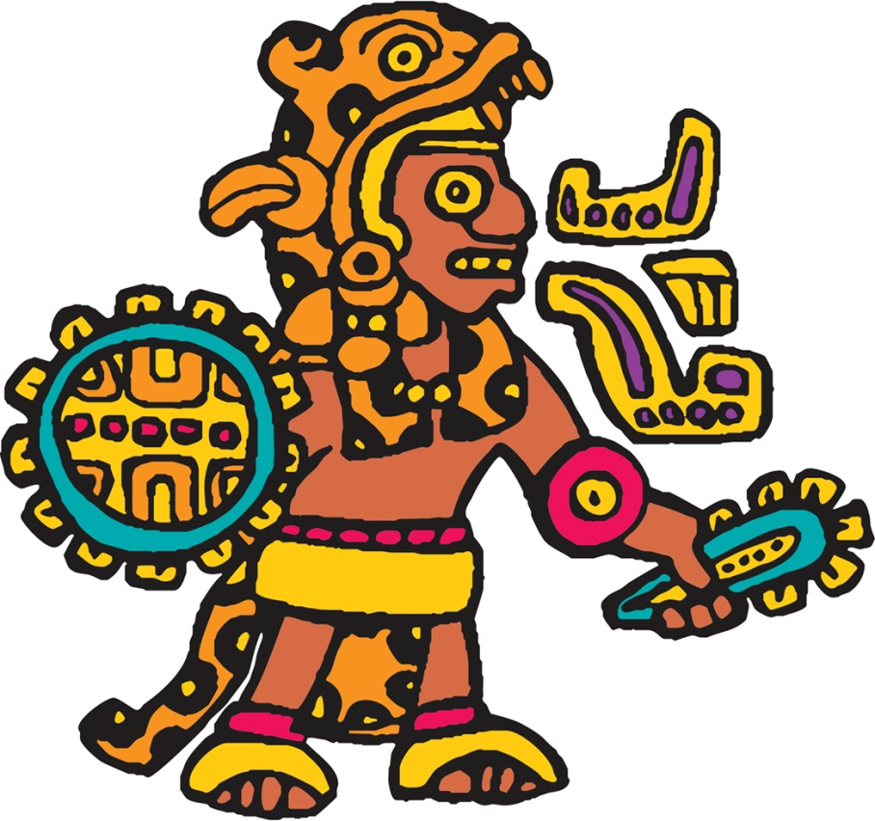
Mexica Society
Hierarchical social structure
  Males potential warriors
  Commoners could improve standing on battlefield
Men of noble birth given most intense training

Slide 17
Warriors
Warriors at the top (elite)
  Mainly drawn from aristocratic class
  Enjoyed land grants, food privileges
  Great wealth, personal adornment

Slide 18
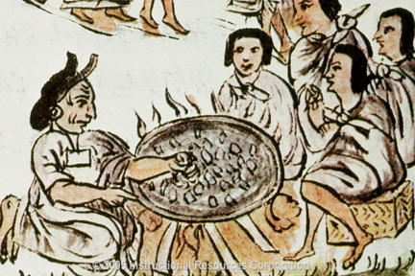
Aztec Women
Patriarchal structure
  No public role
  Didn’t inherit property or hold official positions
  Subjected to strict authority of their fathers and husbands
All married
  Principle function was to bear children, especially males who might become warriors
  Death in childbirth same as death in battle
  Bearing a child same as capturing enemies

Slide 19
Priests
Masters of complex agricultural/ritual calendars
Ritual functions
Read omens, advised rulers
Occasionally became rulers as well
  Ex. Montezuma II

Slide 20
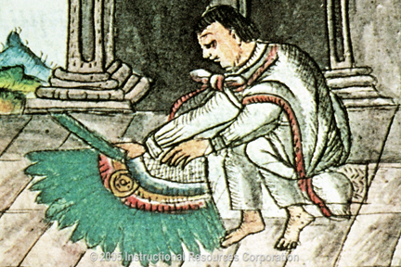
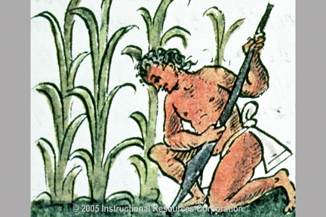
Cultivators and Slaves
Communal groups: calpulli
  Originally kin-based
  Management of communal lands
  Work obligation on aristocratic lands
  Distributed some back to the elite and stored remainder
Slave class
  Worked as domestic servants
  Debtors
  Children sold into slavery

Slide 21
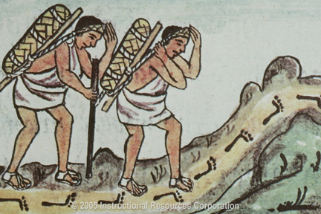
Artisans and Merchants
Skilled artisans enjoyed prestige
Those specializing in long-distance trade often fell under suspicion as “greedy profiteers”

Slide 22
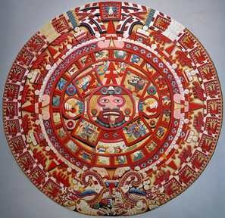
Mexica Religion
Influenced by indigenous traditions from the Olmec period
Ritual ball game
Solar calendar (365 days) and ritual calendar (260 days)
  Not as elaborate as Maya calendar

Slide 23
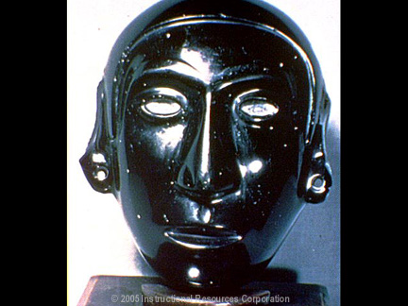
Mexica Gods
Tezcatlipoca (“smoking mirror”)
  Powerful god of life and death
  Patron god of warriors
Quetzalcóatl
  Arts, crafts, agriculture
Huitzilopochtli
  Sun god
  14th century popularity, patron of Mexica
  Emphasis on blood sacrifices

Slide 24
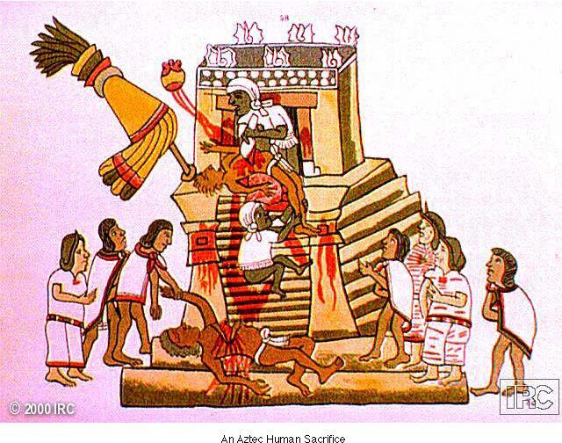
Ritual Bloodletting
Sacrifice and bloodletting to ensure the continuation of the world
More emphasis on human sacrifice than predecessor cultures
Sacrificial victims had tips of fingers torn off before death, ritual wounds
  Victims: Mexica criminals, captured enemy soldiers
Personal rituals: piercing of genitals, earlobes
In this manuscript illustration an aide stretches a victim over a sacrificial altar while a priest opens his chest, removes the still-beating heart, and offers it to Huitzilopochtli. At the bottom of the structure, attendants remove the body of an earlier victim.

Slide 25
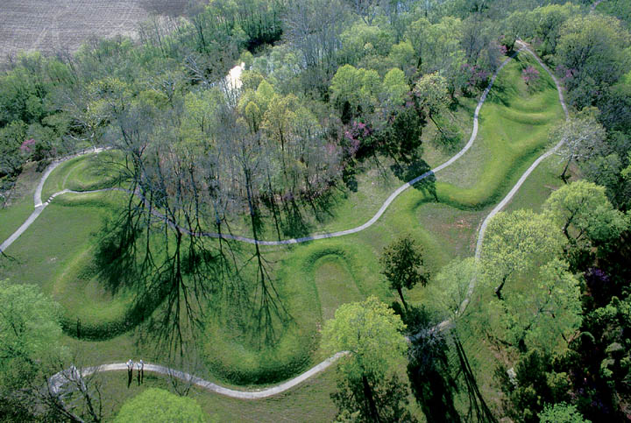
Peoples and Societies of the North
Pueblo and Navajo Societies
  American southwest
  Maize farming 80% of diet
  By 700 CE, construction of permanent stone or adobe dwellings, 125 sites discovered
Iroquois Peoples
  Settled communities in woodlands east of Mississippi
  Live in longhouses where several families lived together
  Women in charge of village/men beyond (hunt, fish, war)
Mound-building peoples
  Ceremonial platforms, homes, burial grounds
  Cahokia large mound near east St. Louis, 900-1250 CE
1000 CE, the Great Serpent Mound in modern Ohio

Slide 26
Mounds and Interpretations
Florida, Georgia, SC, Mississippi, Alabama, Louisiana, Tennessee, Texas, and Arkansas
Settlements flourished around them
Nodes in widespread network of communications and exchange
Euro-American settlers displaced communities and destroyed most of the mounds

Slide 27
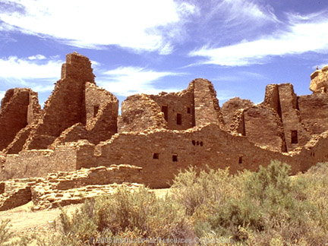
Chaco Canyon in New Mexico

Slide 28
Coming of the Inca
After displacement of Chavín, Moche societies
Development of autonomous regional states in Andean South America
  Both fall and become part of the Incan empire
Kingdom of Chucuito
  Lake Titicaca (border of Peru and Bolivia)
  Potato cultivation, herding of llamas, alpacas
Kingdom of Chimu (Chimor)
  Peruvian coast
  Capital Chanchan (pop. 50,000)

Slide 29
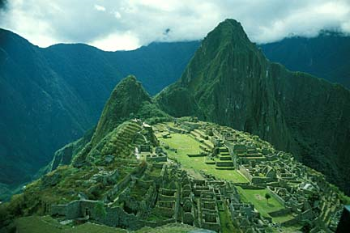
The Inca Empire
From valley of Cuzco
Refers to people who spoke Quecha language
Settlement around Lake Titicaca mid 13th century
Ruler Pachacuti (r. 1438-1471) expands territory
  Modern Peru, parts of Equador, Bolivia, Chile, Argentina
  Population 11.5 million

Slide 30
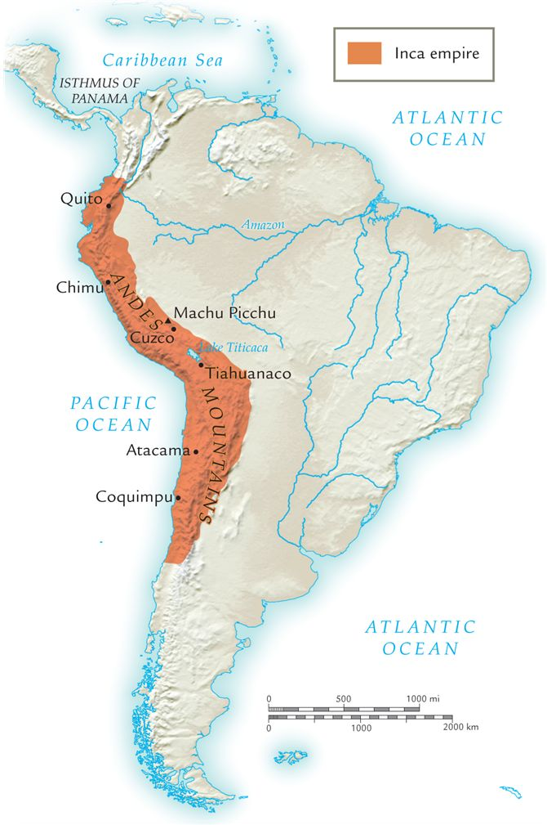
The Incan Empire
Incas built the largest empire in the pre-Columbian Americas.
How and why did they conquer and expand?
  Religion played a part

Slide 31
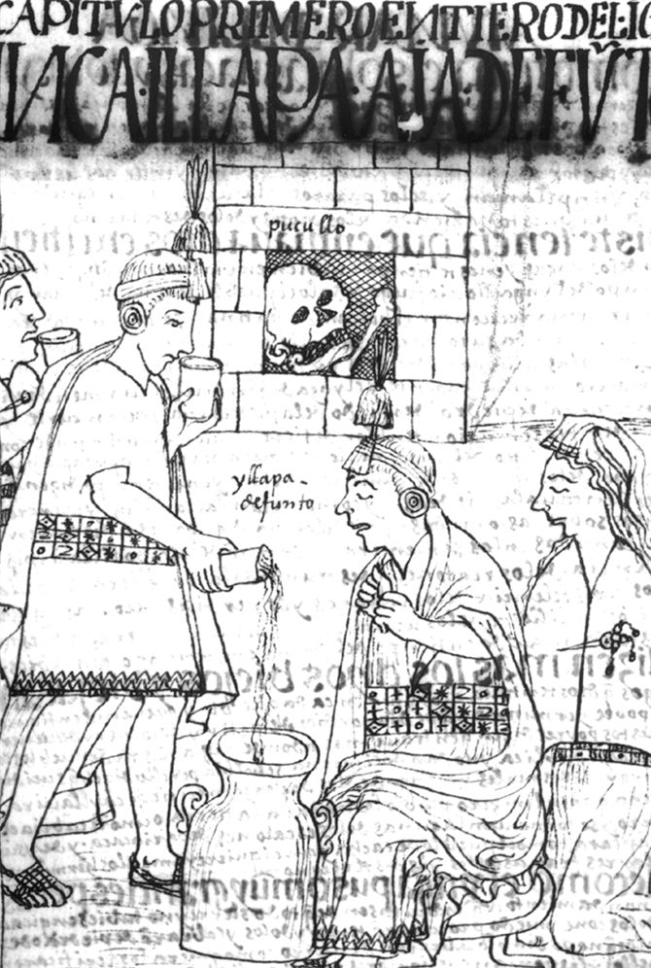
Incan Society
Social elites dominated by infallible king
  Claimed descent from the sun
Worship of ancestors
  Royals remains preserved in mummified form
  Regularly consulted
  Sacrifices offered
  Paraded on festive occasions
Descendants prepare a ritual meal for a mummified Inca ruler (depicted in the background).

Slide 32
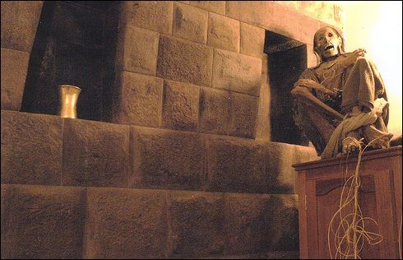
Practice of Royal Split Inheritance
Reason for conquest?
Inca practice of descent of rulers
  All titles and political power went to successor, but wealth and land remained in hands of male descendants for support of cult of dead inca’s mummy
  Inca rulers had to secure on land, labor, tribute

Slide 33
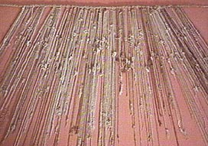
Quipu and Incan Administration
No writing so used “knotted strings” called quipu
Records statistical info
Helped them keep track of information in empire
  Ex. Census, financial records

Slide 34
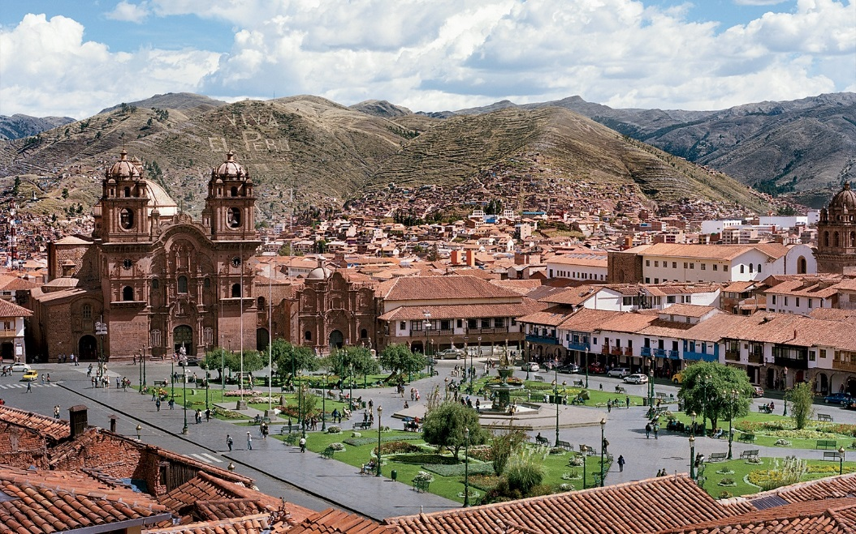
Cuzco
Religious, ceremonial, and administrative capital of Incan empire
Residents rulers, high nobility, priests, hostages
Gold facades on buildings

Slide 35
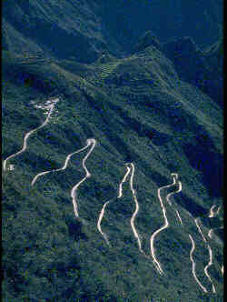
Incan Roads
Massive road building system
Two north-south roads, approximately 10,000 miles
  Mountain route
  Coastal route
Paved, shaded, wide roads
Courier and messenger services
Limited long-distance trade, held by government monopoly

Slide 36
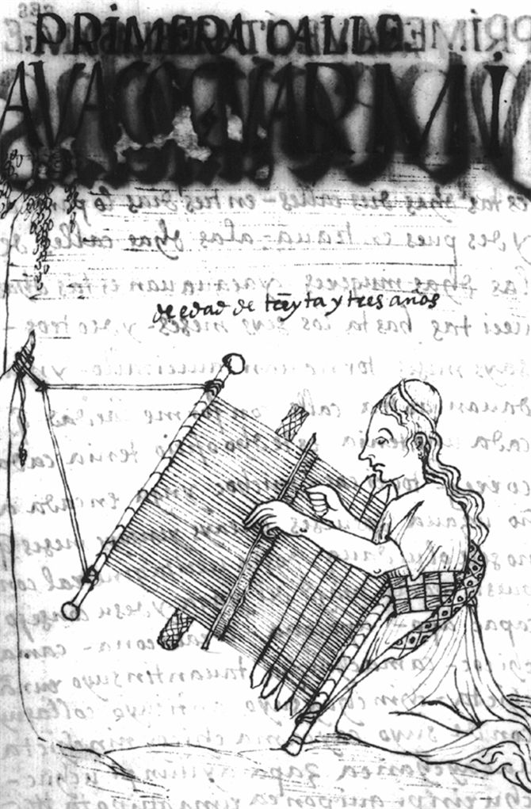
Aristocracy, Priests, and Peasants
Aristocrats receive special privileges
  Earlobe spools as adornment
Priestly class ascetic, celibate
Peasants organized into community groups called ayllus
  Aztecs called it “calpulli”
  Land, tools held communally
  Mandatory work details on land of aristocrats, mita
  Public works
Fulfilling her tribute duty to the Inca state, an Inca woman weaves woolen fabric on a loom attached to a tree.

Slide 37
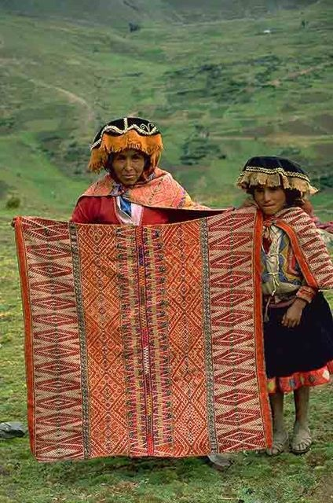
Mita
Labor extracted for lands assigned to the state and the religion
  Ex. Bldg projects, mining
  Ex. Women weave high-quality cloth for court or religious purposes
All communities were expected to contribute
An essential aspect of Inca imperial control

Slide 38
Political Achievement
Inca imperial rule controlled an area of almost 3,000 miles
How did they integrate w/ regional and ethnic differences
  Quechua-intentionally spread throughout empire
  Reciprocity b/n state and local community
    Ex. Inca state provides roads, irrigation projects, hard-to-get items and extracted labor power for this

Slide 39
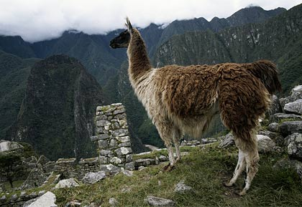
Inti sun god
Viracocha creator god
Some animist beliefs also holy shrines
Temples as pilgrimage sites: Temple of the Sun
Peasant sacrifices usually produce, animals (not humans)
Sin brought divine disaster
Llama was used in South America as beasts of burden. It was sometimes sacrificed to the gods.

Slide 40
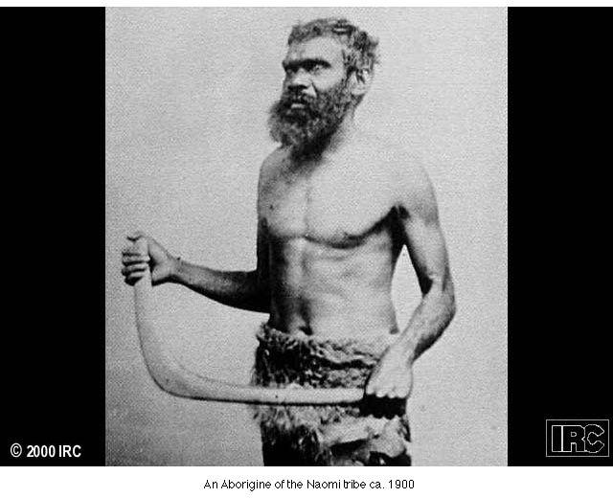
The Societies of Oceania
Nomadic foragers of Australia
  Virtually static culture
    No agriculture
New Guinea
  Swine herding, root cultivation c. 5000 BCE
Small-scale trade of surplus food, some goods
  Pearly oyster shells, spears, boomerangs

Slide 41
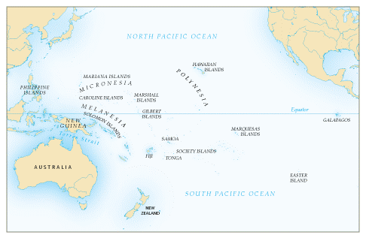
Pacific Island Societies
Established in almost all islands in early centuries BCE
Trade between island groups
Long-distance voyaging on intermittent basis
  Brought sweet potatoes from South America c. 300 CE
  Voyages preserved in oral traditions

Slide 42
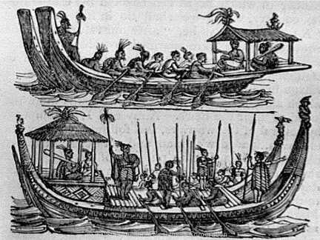
Population Growth
Extensive cultivation
Fishing innovations
  Fish ponds allow small fish in, trap larger fish
Population density leads to social strife, economic degradation
C. 1500 CE fierce fighting, cannibalism

Slide 43
Development of Social Classes
Complexity of population leads to articulation of distinct classes
  High chiefs, lesser chiefs, commoners, artisans, peasants
Small multi-island empires form
  Limited before 19th century
  Yet controlled land allocation, labor and military conscription

Slide 44
Polynesian Religion
Priests as intermediaries to divine
Gods of war, agriculture most prominent
Ceremonial precinct or temple: Marae (heiau)

