Slide 1
Today- May 12th
1. Bell Work- Discuss
2. Map- Pre-WWII
3. Packet Review
4. WWII notes and discussion
5. Exit Ticket
Introduce homework due next week.

Slide 2
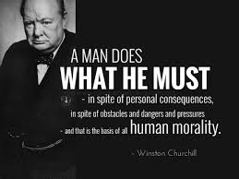
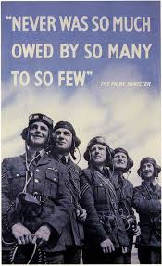
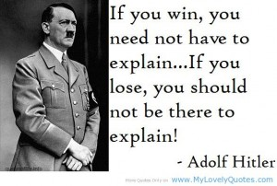
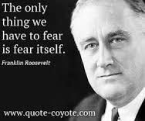
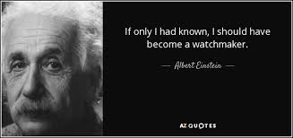
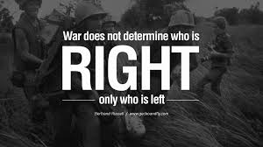
Choose a quote

Slide 3
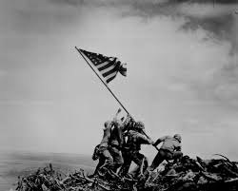
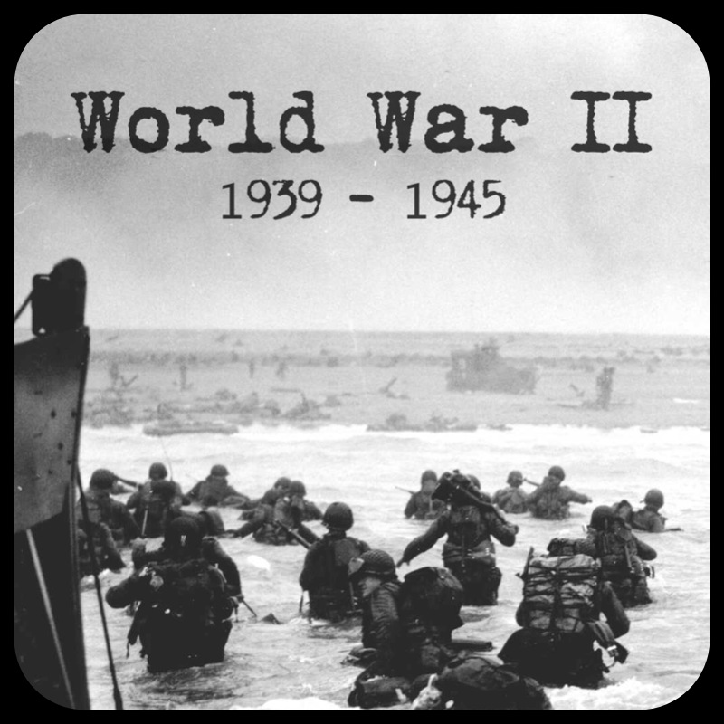
World War II

Slide 4
Standard 7
The student will demonstrate an understanding of the causes and consequences of global warfare in the first half of the 20th century
Role of nationalism and propaganda in mobilizing civilian populations.
Analyze the ways that the governments of Britain, France, Germany and Italy responded to political changes of the 1920s and 1930s.

Slide 5
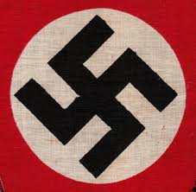
WWII Background- Pre-war (1920s and 1930s) https://www.youtube.com/watch?v=AnpTWKKWQ1o
What was happening in Italy?
What was happening in Germany?
Japan?
United States?
China?
Russia? (Soon-to-be Soviet Union)

Slide 6
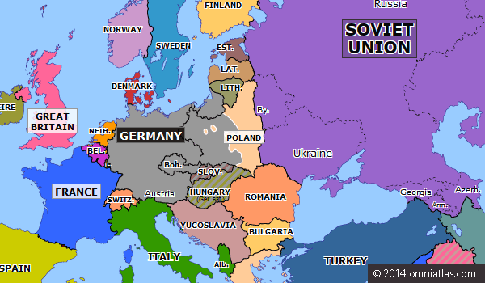
Map of Europe- 1939

Slide 7
Timeline of Events Pre-War
1931- Japan takes over Manchuria
1932- Hindenburg elected President of Germany (defeats Hitler)
1932- FDR elected President of the USA
1933- Hindenburg appoints Hitler chancellor of Germany
1933- FDR and the New Deal
1933- Dachau (first concentration camp) established in Germany- Ms. T has been there ☹
1933- Japan and Germany leave the League of Nations
1934- Hitler assumes power when Hindenburg dies
1935- Nuremburg Laws are passed/US Neutrality Acts
1936- Spanish Civil War begins/Rome-Berlin Axis/Japan and Germany anti-communism pact (anti-comintern)
1937- Japan invades China
1938- Anschluss (Austria is annexed by Germany)
1938- Policy of appeasement is practiced
1938- Kristallnacht
1939- Germany annexes Czechoslovakia
1939- Nazi-Soviet non-aggression pact
1939- Germany invades Poland.

Slide 8
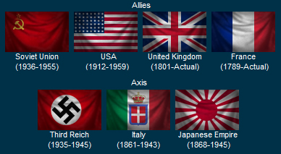
Who are the players?

Slide 9
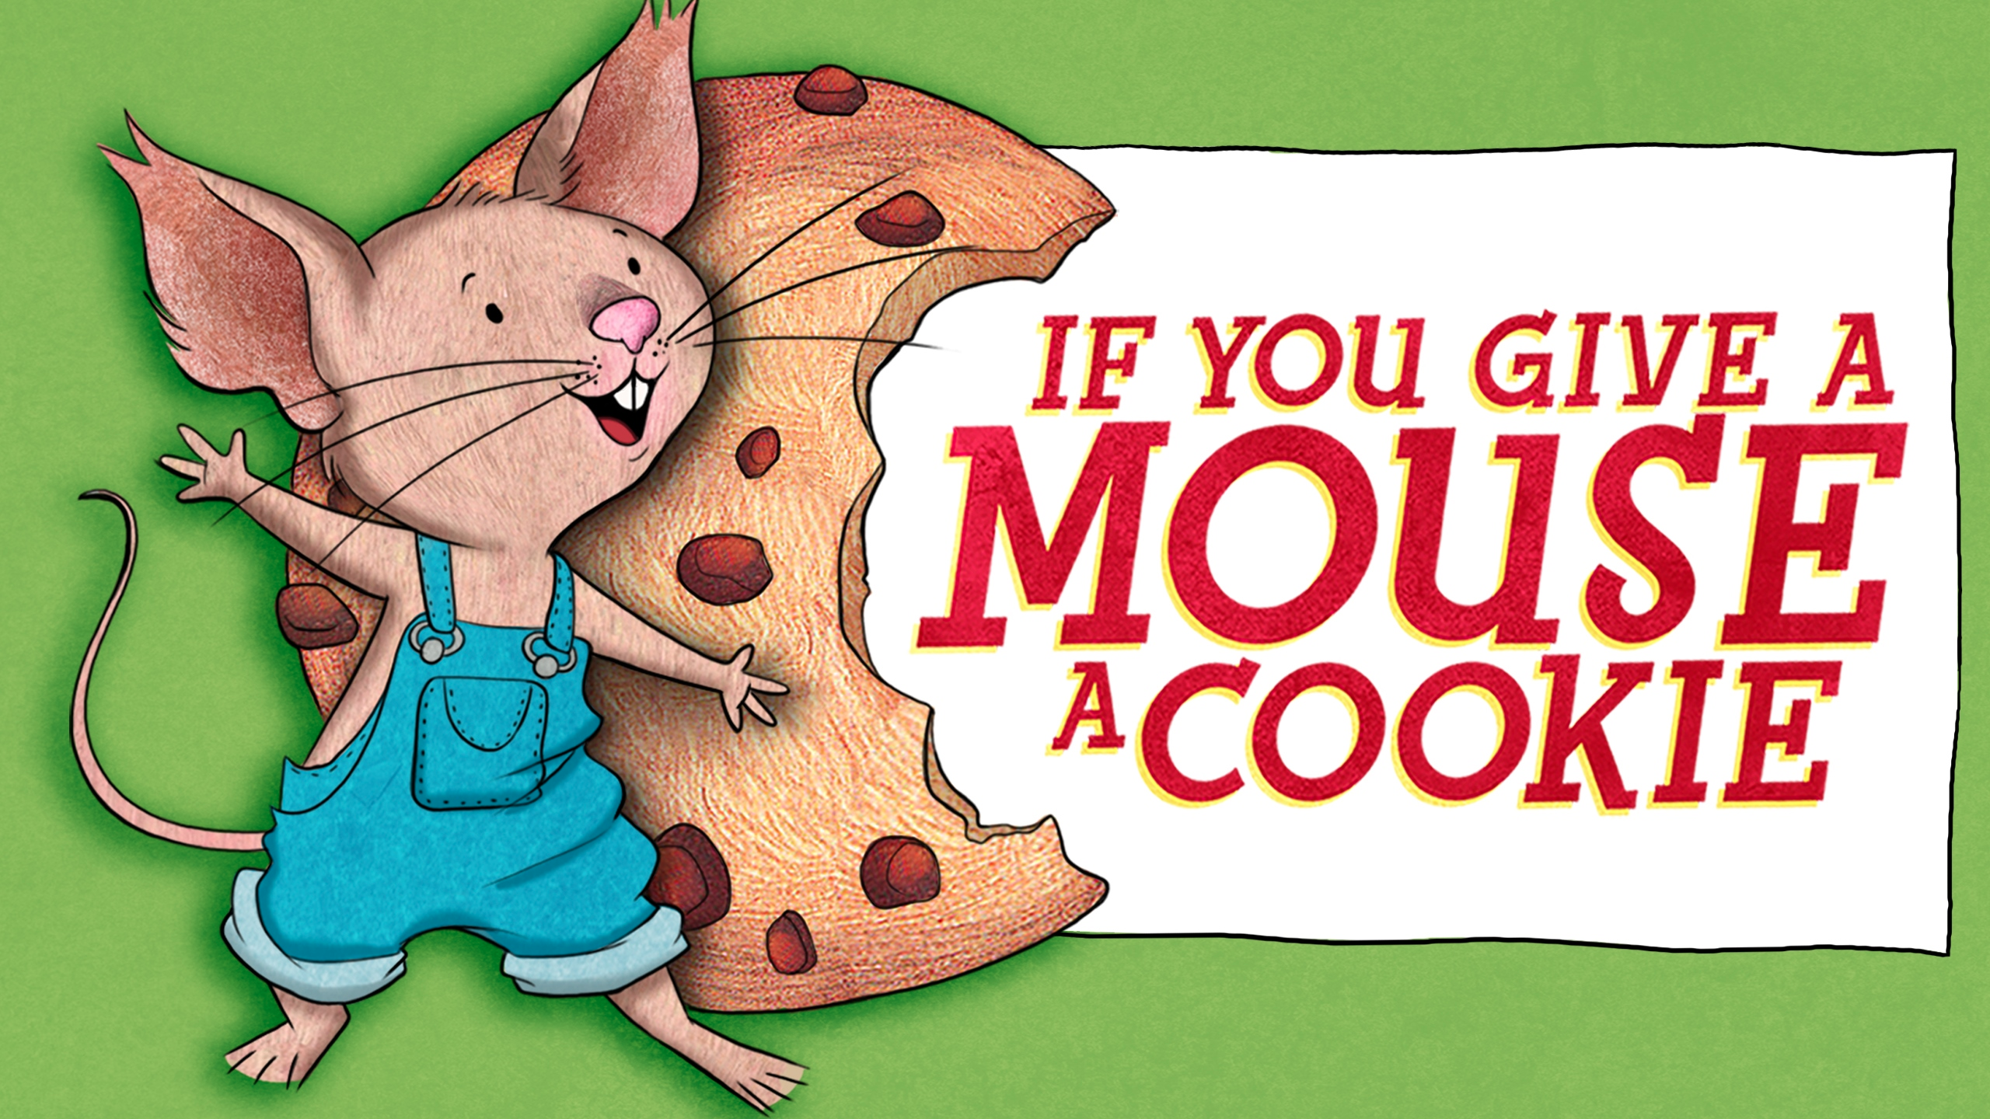
So… How does it begin?
What does the term appeasement mean? (Rhineland, Austria, and Czechoslovakia {Sudetenland})
What is decided at the Munich Conference?
If you give a mouse a cookie!
Non-Aggression Pact with the Soviet Union
Why does Hitler invade Poland? (9-1-1939)

Slide 10
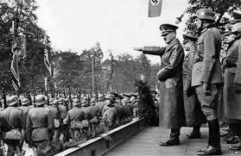
Response
France and Britain declare war on Germany on September 3rd, 1939
Poland is quickly defeated and surrenders (Blitzkrieg- lightening war)
Soviet Union defeats part of Poland, Latvia, Estonia and Lithuania quickly and soon after defeats Finland.
https://www.youtube.com/watch?v=SdzXr144VzE

Slide 11
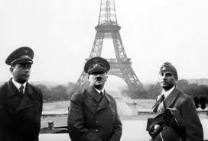
The Fall of France- 1940
Hitler sweeps across the Netherlands, Belgium and Luxembourg
The Germans take France on June 14, 1940
Who is the only power left to fight Germany?

Slide 12
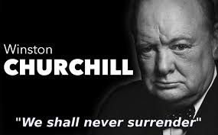
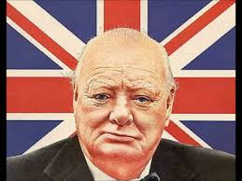
Churchill and Great Britain
Churchill- “We shall never surrender!”

Slide 13
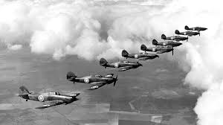
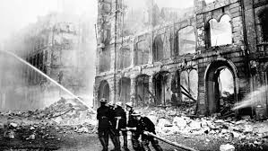
The Invasion of GB
Hitler attempts an invasion of Great Britain.
Battle of Britain-
Summer of 1940 the Luftwaffe invades and bombs Great Britain
The British resist and Hitler decides to call off his attacks to focus on the Mediterranean and Eastern Europe.
The Allies now know Hitler can be stopped!

Slide 14
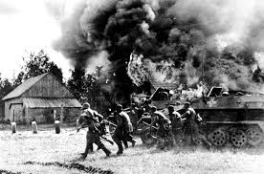
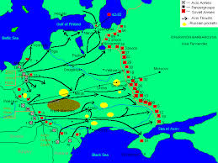
Hitler invade the Soviet Union! (June 1941)
Bulgaria, Romania, and Hungary all join the Axis
Yugoslavia and Greece attempt to resist but are defeated
Hitler invades the Soviet Union-
??? Why would he do this?
Soviets practice “scorched-earth policy” (remember this?)

Slide 15
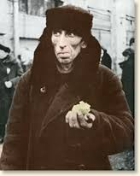
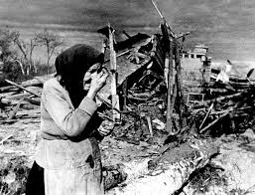
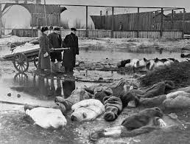
Battle of Leningrad
Battle of Leningrad- 1 million people died at Leningrad (many starved to death and lived off merely rats and crows).
The city refused to fall!
Hitler would not let the Germans retreat- Germany loses 500,000!
What does this say about Hitler?

Slide 16
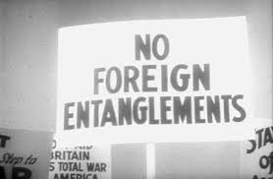
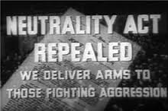
United States
Neutrality Acts (1935, 1937)
Cash and Carry (1939)
Lend-Lease (1941)
Why do you think that it took the USA so long to enter the war?
What do you think it should take to finally enter war?

Slide 17
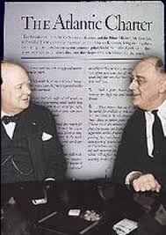
Atlantic Chater
1941-
Join declaration between Roosevelt and Churchill
US still has not officially entered the war
“Free trade among nations and the right of people to choose their own government.”
United States enters unofficial war with Germany but the first attack comes from somewhere else…

Slide 18
Japan!- “A day which will live in infamy”
Pearl Harbor, Hawaii- December 7th, 1941
3500 casualties (2300 dead)
Reasons behind the attack at Pearl Harbor-
Oil
USA cuts off oil supply to Japan when Japan invades Vietnam, Cambodia and Laos.

Slide 19
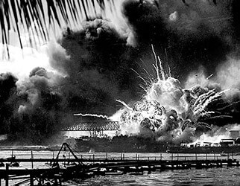
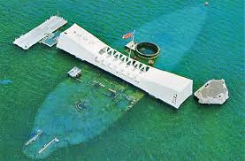
December 7, 1941
https://www.youtube.com/watch?v=bxIsVYdB0lA

Slide 20
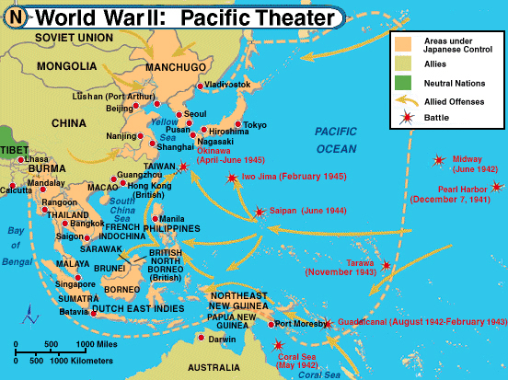

Slide 21
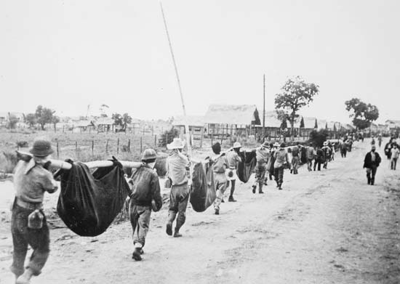
Other Japanese Victories
Hong Kong, Wake Island, Guam, Philippines, Malaya, Indonesia and many more
Bataan Peninsula- Philippines
Bataan Death March- POWs marched 50 miles up the Peninsula
70,000 begin the march and only 54,000 survive

Slide 22
Bataan Death March
“I was questioned by a Japanese officer, who found out that I had been in a Philippine Scout Battalion. The [Japanese] hated the Scouts…Anyway, they took me outside and I was forced to watch as they buried six of my Scouts alive. They made the men dig their own graves, and then had them kneel down in a pit. The guards it them over the head with shovels to stun them and piled the earth on top.”
- Lieutenant John Spainhower

Slide 23
Pacific Strategy
Island hopping (leap-frogging)- what is this?
General Douglas MacArthur- commander of Allied land forces in the pacific
Battle of Midway- biggest turning point in the war!
Japanese forced to withdraw from the island

