Slide 1
Wwii Totalitarian Rise to Power
Chapter 31

Slide 2
Bell Work- Review yesterday
Characteristics of a good leader- Best leaders in history?- Discussion
Homework check!
Read the back portion of your homework and annotate it. What are the main complaints or wishes of the author of the speech?

Slide 3
Totalitarianism
A gov’t that takes total, centralized state control over every aspect of public and private life
Mass communications made it possible to reach into all aspects of their lives
Joseph Stalin at a Soviet congress in 1936. By 1928 Stalin had prevailed over his opponents to become the dictator of the Soviet Union, a position he held until his death in 1953.

Slide 5
Methods of Control
Police Terror
To enforce gov’t policies
May use spying, brutal force, or murder
Indoctrination
Instruction in the gov’ts beliefs
Begins very young
Propaganda and Censorship
Biased or incomplete information to sway people to accept beliefs
Control mass media
Suggesting that it is incorrect is treason and punished
Imprisonment or killed
Religious or ethnic persecution
“Enemies of the state”

Slide 6
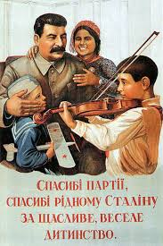
Propaganda and Censorship
Controlled all newspaper, motion pictures, radio etc.
Writers, composers, artists censored
No toleration of individual creativity
Rewarded those artists who created works of propaganda
All glorified the achievements of the Communist state, Stalin

Slide 7
Fascism
A political movement that promotes extreme form of nationalism and militarism.
It pledges loyalty to an authoritarian leader who guides and brings order
The state is supreme
It is more important than the individual
It includes a denial of individual rights
It includes a dictatorial one-party rule
Wore uniforms of certain color, used special salutes, held mass rallies
Word comes from Latin for fascis, a bundle of wooden rods tied around an ax handle. This was a symbol of authority in ancient Rome.

Slide 8
Comparing Fascism to Communism
Fascism
Did not seek classless society
Seek classless society
Dictator with one party rule
Internationalist, who were hoping to unit workers worldwide
State is supreme and no individual rights
They were nationalists
It has a place and function
Communism

Slide 9
Mussolini’s Italy
Seeking radical answers in response to WWI
Italy disappointed
Benito Mussolini (1922-1943)
Great orator who glorified warfare and & Italian nation
Leader of the Fascist party in Italy
1922 appointed prime minister
Known for his bombastic speeches, spectacular parades, and signs proclaiming “Il Duce is always right!”

Slide 10
Fascism in Italy
Install Fascist members in all gov’t jobs, crush opposition parties
1,000s imprisoned, exiled, or executed
Take over press, education, youth activities and gave employers control over workers
Mussolini’s genius was how he applied modern mass communications & advertisements to political life
His techniques will be mimicked by others in Europe, Latin America, China, and Japan
1936 Mussolini forms alliance with Hitler known as the Rome-Berlin Axis-…”world history would revolve around a Rome-Berlin Axis”
“…the twentieth century will be a century of fascism, the century of Italian power.” Mussolini, 1932

Slide 11
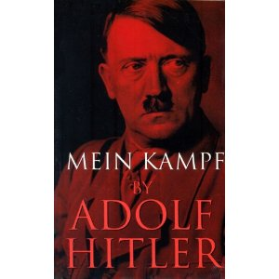
Nazism
1921 Hitler becomes chairman of the National Socialist German Workers Party –Nazi Party
1923 Hitler and party attempt to overthrow the democratic Weimar Republic
Hitler is jailed and released in 1924
Writes Mein Kampf in prison
He reorganizes with goal of gaining power legally
Hitler and all defendants before trial after the attempted coup d’etat known as the Beer Hall Putsch.

Slide 12
Hitler’s Goals from Mein Kampf
Believed Germany should incorporate all German-speaking areas

Slide 13
The Master Race
“Alpine Race “ French and Italian
Russian and Eastern Slavs – The slaves of the master race
Aryan Race- Germans, Scandinavian, Britons
The most intense hatred was for the Jews
Blamed for every disaster of the Germans
The defeat of WWI
Looked for the day when the “Master Race” would dominate

Slide 14
Lebensraum
Goal was to repeal the humiliation and military restrictions of Treaty of Versailles
Plan to annex all German-speaking territory to Germany
Living space to the east
Plan to eliminate all Jews

Slide 15
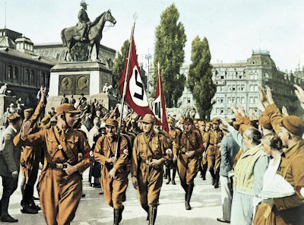
The Nazi Party in the 1920’s
For most Germans, his ideas are too extreme
When Depression hits, they gain supporters among the unemployed and property owners frightened by the growing popularity of Communism

Slide 16
The Third Reich
B/n 1930-32, the Nazi Party became the largest party in parliament
President Paul von Hindenburg offers him chancellorship
1933 Hitler becomes chancellor of Germany where he quickly assumed dictatorial powers
Nazis in charge of gov’t agencies, education, professional organizations
Banned all other political parties and threw their leaders into concentration camps or murdered
Hitler’s promise: A German Third Reich that would endure for a 1,000 years.
Political prisoners lined up at a concentration camp at Oranienburg

Slide 17
A 1924 painting of Hitler as a knight in shining armor, as the standard-bearer for National Socialism, became the state-sanctioned Hitler portrait for 1938; reproductions in poster and postcard form proved very popular.

Slide 18
The Racial State
Jews
Deprived of their citizenship and civil rights
Prohibited from marrying Aryans
Ousted from professions
Confiscated their property
Introduce measures to improve quantity and quality of the German race
Encouraged procreation among young people
Allowances and rewards for having children
“Mother and Child” was the slogan on this poster, idealizing and encouraging motherhood. The background conveys the Nazi predilection for the wholesome country life, a dream that clashed with the urban reality of German society.

Slide 19
Nazi Eugenics
Obsessed with “quality”, regime initiated a compulsory sterilization program for men and women whom they identified as having sicknesses
Schizophrenia, feeblemindedness, manic depression, hereditary blindness or deafness, chronic alcoholism, physical deformities
Also sanction abortions for them
200,000 euthanized and becomes precursor to the systematic extermination of the Jews
“This person suffering from hereditary defects costs the community 60,000 Reichsmark during his lifetime. Fellow German, that is your money, too.”

Slide 20
A Nazi “racial expert” uses a caliper to measure the racial purity of a German.

Slide 21
Anti-Semitism
1933 the Nazis initiate systematic measures to suppress Jewish population
Nuremberg Laws deprived them of citizenship, marriage or intercourse w/ Germans
Jewish civil servants lost jobs, lawyers, doctors lost non-Jewish clients
Liquidation of Jewish-owned businesses and purchased them at low prices
Throughout 1930s thousands left
Under a sign saying "With the Stürmer against the Jews" is a page display beneath the Nazi slogan "The Jews are our misfortune."

Slide 22
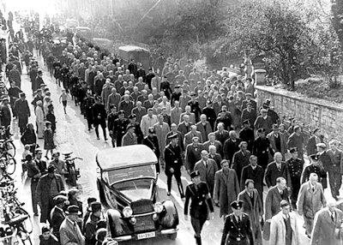
Kristallnacht- “Night of the Broken Glass”
Goal was for Jewish emigration
Gained urgency after Kristallnacht
Nov. 9-10, 1938, the Nazis arranged for the destruction of 1000s of Jewish stores, burning most synagogues, and the murder of more than 100 Jews
Became a signal to Jews of what would come
250,000 left by 1938
Aftermath of Kristallnacht
Jewish men at Baden-Baden in Germany are marched off under heavy guard to a concentration camp - marking the advent of Nazi mass roundups of Jews.

